Slide 1
5) ESCCCP24 2025-2026 26 Mar 2026

Slide 2
Check-in
26 Mar 2026

Slide 3
Work from 19 Mar 2026
Using Writing a film review.pptx made from
07) PlusPreIntU7 Film review.pdf, we
learnt to write a film review.
Homework
07) PlusPreIntU7 Film review.pdf
Using the plan template in Ex 3 p. 56 of 07) PlusPreIntU7 Film review.pdf , or your own plan – experience has taught me that not everyone likes this framework, plan and write a film review of a film of your choice. P. 56 Ex 4. Use Writing a film review.pptx to help you.

Slide 4
Reading/Writing
17:45-20:45

Slide 5
Running order
Reading booklet Week 4 –
0) Reading Booklet
Skimming, scanning, close reading, (not exegesis)
Reading Paper A
L2 R - Paper A (1).pdf
L2 R - Paper A - Mark Scheme.pdf
Finish for HW.

Slide 6
Reading Strategy | Type of Interpretation | Role
Skimming | Global / gist | Establishes a first understanding of the whole text
Scanning | Specific / targeted | Interprets only the exact information needed
Close Reading | Detailed / analytical | Builds full, deep meaning from the text

Slide 7
Skimming (A2)
Skimming is reading a text quickly to find the main idea.
Scanning (A2)
Scanning is reading a text quickly to find one piece of information, like a number, name, or date.

Slide 8
Close reading means examining the words, structure, and details inside a text very carefully to understand exactly what it says.
It focuses on:
vocabulary
grammar
cohesion
tone
organisation
literal and implied meaning
Close reading stays inside the text.
Do not be tempted to go outside of the text.

Slide 9
Exegesis = Why it says it, what it means in context, and how we can explain that meaning clearly
Exegesis uses:
close reading (the text itself)
context (when/where it was written, who for, why)
purpose (the writer’s intention)
background knowledge (cultural, social, situational)
reasoned explanation (a structured interpretation)
This takes you beyond the text into a fuller, supported interpretation. Do not do this.

Slide 10
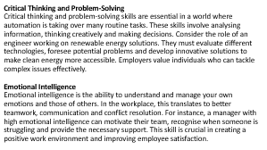
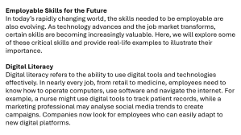
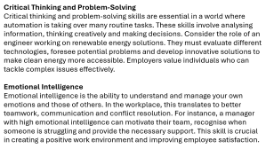
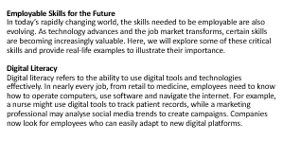
1. What is digital literacy?
Digital literacy is the ability to use digital tools and technologies effectively.
2. How might a nurse use digital tools in their job?
A nurse might use digital tools to track patient records.
3. Why are critical thinking and problem‑solving skills important in today’s job market?
They are important because automation is replacing many routine tasks, so workers need to analyse information, think creatively and make good decisions.
4. Give an example of a role that requires critical thinking and problem‑solving.
An engineer working on renewable energy solutions.
5. What is emotional intelligence?
Emotional intelligence is the ability to understand and manage your own emotions and the emotions of others.

Slide 11
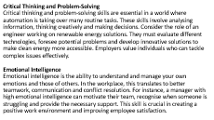


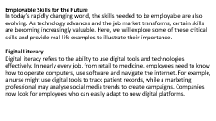
6. How can emotional intelligence improve a workplace environment?
It improves teamwork, communication and conflict resolution, creating a more positive and supportive workplace.
7. Why is adaptability important in the modern job market?
Adaptability is important because the nature of work is changing quickly, and new types of jobs are constantly emerging.
8. Describe an example of adaptability in the context of teaching.
A teacher showed adaptability by shifting from in‑person classes to online teaching during the COVID‑19 pandemic and learning to use virtual platforms.
9. What does collaboration involve?
Collaboration involves working effectively with others to achieve common goals.
10. Provide an example of how collaboration is used in software development.
In software development, programmers, designers and testers work together as a team to create a new application.

Slide 12
Employable Skills for the Future
In today’s rapidly changing world, the skills needed to be employable are also evolving. As technology advances and the job market transforms, certain skills are becoming increasingly valuable. Here, we will explore some of these critical skills and provide real-life examples to illustrate their importance.
Digital Literacy
Digital literacy refers to the ability to use digital tools and technologies effectively. In nearly every job, from retail to medicine, employees need to know how to operate computers, use software and navigate the internet. For example, a nurse might use digital tools to track patient records, while a marketing professional may analyse social media trends to create campaigns. Companies now look for employees who can easily adapt to new digital platforms.

Slide 13
Critical Thinking and Problem-Solving
Critical thinking and problem-solving skills are essential in a world where automation is taking over many routine tasks. These skills involve analysing information, thinking creatively and making decisions. Consider the role of an engineer working on renewable energy solutions. They must evaluate different technologies, foresee potential problems and develop innovative solutions to make clean energy more accessible. Employers value individuals who can tackle complex issues effectively.
Emotional Intelligence
Emotional intelligence is the ability to understand and manage your own emotions and those of others. In the workplace, this translates to better teamwork, communication and conflict resolution. For instance, a manager with high emotional intelligence can motivate their team, recognise when someone is struggling and provide the necessary support. This skill is crucial in creating a positive work environment and improving employee satisfaction.

Slide 14
Check-out
26 Mar 2026

Slide 15
Work from 26 Mar 2026
Reading booklet Week 4 –
0) Reading Booklet
Skimming, scanning, close reading,
Reading Paper A Tasks 1 &2
L2 R - Paper A (1).pdf
L2 R - Paper A - Mark Scheme.pdf
Finish for HW.
Homework
Reading Paper A Tasks 3 & 4.

